Slide 1
Kafka Definitive Guide
Summary By NgocTD

Slide 2






Messages and Batches
Collection of messages
Being produced
to the same topic and partition.
The unit of data.
An array of bytes.
Latency and throughput.
Written to the same partition
By modulo the total number
of partitions in the topic.
Batches compressed.
Notes:
The unit of data within Kafka is called a message.
Message is similar to a row or a record in db.
Data contained in a message (byte doesn’t have a specific format or meaning to Kafka.

Slide 3


Topics and Partitions
Categorized into topics.
Broken down
into a number of partitions.

Slide 4

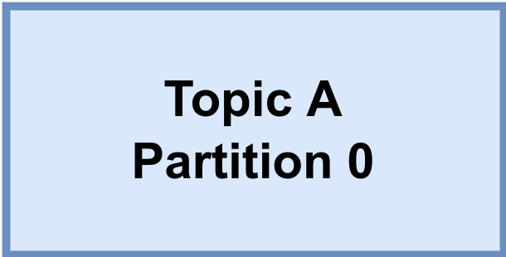

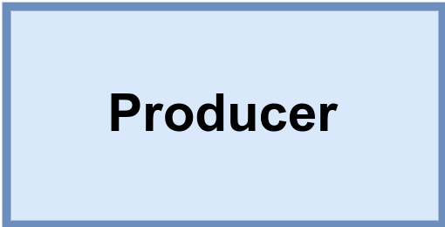
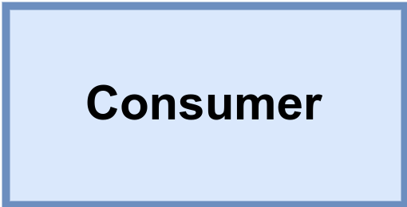

Brokers and Clusters
Kafka cluster
Messages
for A/0
Messages
from A/0
Leader
Replicate
A/0
Replicate
A/1
Messages
for A/1
Messages
from A/1
Leader

Slide 5
Multiple Clusters

Slide 6
Use cases
Activity tracking.
Commit log.
Messaging.
Streaming processing.
Metrics and logging.

Slide 7
Kafka Producers: Writing Messages to Kafka
Topic A
Partition 0
Batch 0
Batch 1
ProducerRecord
Batch 2
Topic
Kafka broker
Send()
[Partition]
Serializer
Partitioner
[Key]
Topic B
Partition 1
Value
Batch 0
When successful,
return metadata
include topic, partition
and the offset
If can’t retry,
throw
exception
Batch 1
Batch 2
Retry?
Fail?
Notes:
Once we send the ProducerRecord, the first thing the producer will do is serialize the key and value objects to byte arrays so they can be sent over the network.

Slide 8
Kafka Consumers: Reading Data from Kafka
Topic T1
Consumer group 1
Partition 0
Consumer 1
Partition 1
Consumer 2
Partition 2
Consumer 3
Partition 3
Consumer 4
Consumer 5

Slide 9
Kafka Consumers: Reading Data from Kafka
Topic T1
Consumer group 1
Partition 0
Consumer 1
Partition 1
Consumer 2
Partition 2
Consumer 3
Partition 3
Consumer 4
Consumer group 2
Consumer 1
Consumer 2

Slide 10
Consumer Groups and Partition Rebalance
Notes:
Moving partition ownership from one consumer to another is called a rebalance. Rebalances are important because they provide the consumer group with high availability and scalability

